Slide 1
Media, Sports, Gambling, and Life through Statistics
Matt Smerglia, Stephen Wu

Slide 2
Introduction
Goals:
Interest people in the field of statistics and its applications
Make people more cognizant of poor visualizations and statistical confidence
Discuss interesting statistics applications in real-life
Matt Smerglia
STEM EE 2nd Year, Statistics for Industry and Sport Industry (PSP)
Stephen Wu
STEM EE 1st Year, Computer Science Engineering
Notes:
Introduce speakers:
Matt: discuss major and interest in sports
Stephen: discuss major/minor, interest in statistics and cs models

Slide 3
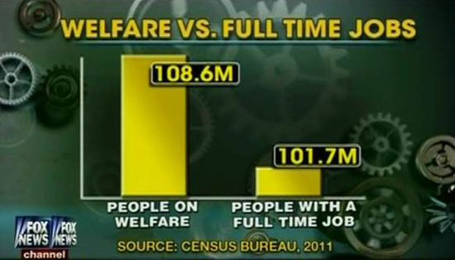
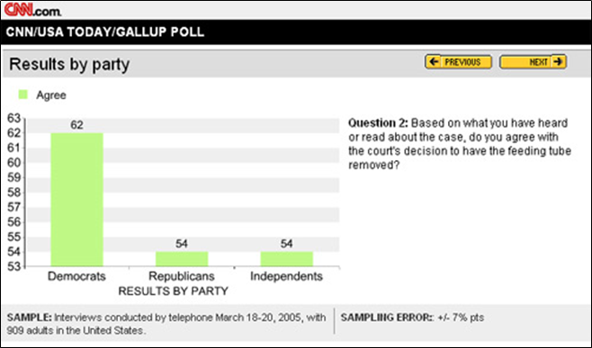
Statistics in the Media
CNN posting Gallup poll about Terry Schiavo case
Fox News graphic comparing quantity of people on welfare to people with a full time job
What features of these graphs are potentially misleading?
Notes:
M

Slide 4
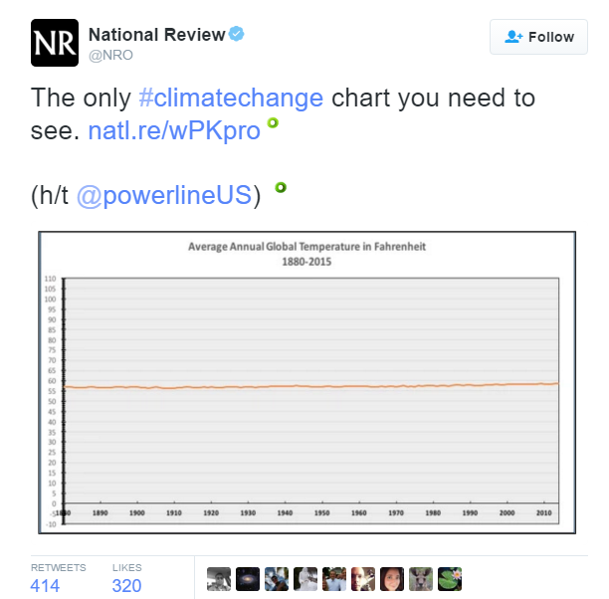
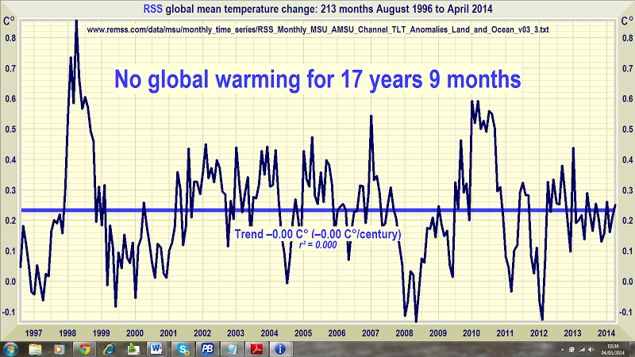
What global warming?
Satellite data from 17 years, RSS model, from Climate Depot
National Review tweet about climate change
What features of these graphs are potentially misleading?
Notes:
M

Slide 5
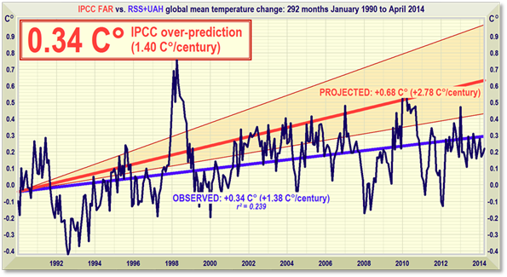
What global warming?
“Many of the alarmists on global warming, they’ve got a problem because the science doesn’t back them up. In particular, satellite data demonstrate for the last 17 years, there’s been zero warming.”
— Ted Cruz, 2016 presidential candidate
Between 1997 and 1998, there was an unusually strong El Niño, and this caused 1998 to be one of the hottest years on record...When the 1998 measurement is included in the data, it looks as if there is no overall warming between 1998 and 2008 at all...Claims that global warming is not occurring that are derived from a cooling observed over short time periods ignore natural variability and are misleading."
— Josh Willis, NASA Climate Scientist
Satellite data, RSS, IPCC models, from Climate Depot
Notes:
M

Slide 6
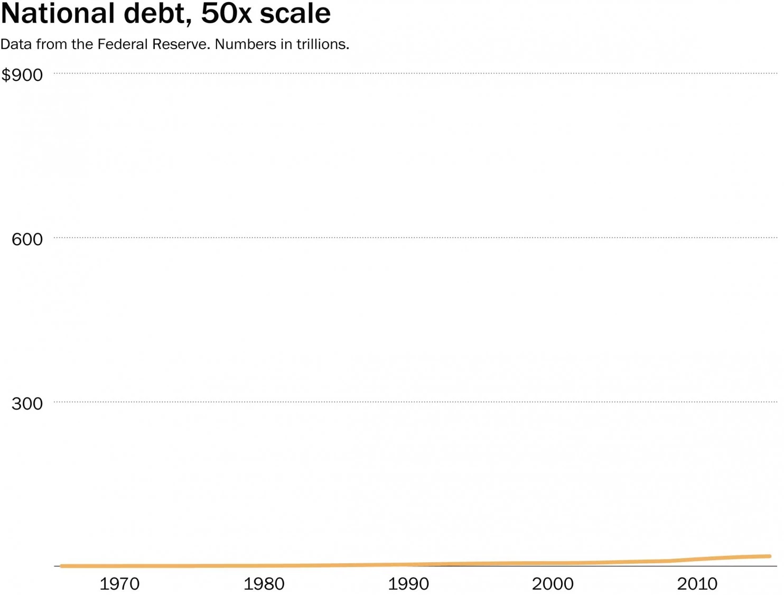
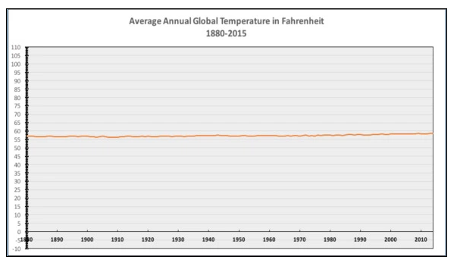
What global warming?
What national debt?
National Review graph about climate change
“The only #climatechange chart you need to see.”
— National Review, very popular conservative news magazine
National debt over 40 years from Washington Post
Notes:
S

Slide 7
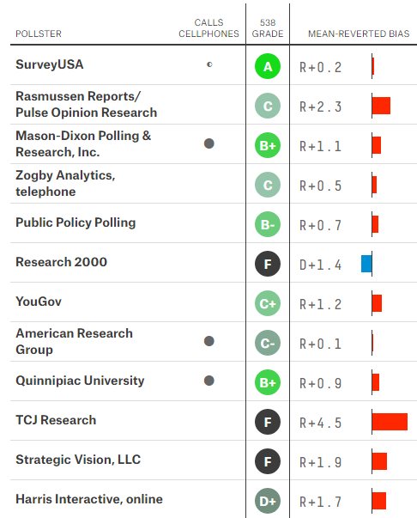
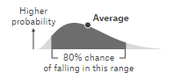
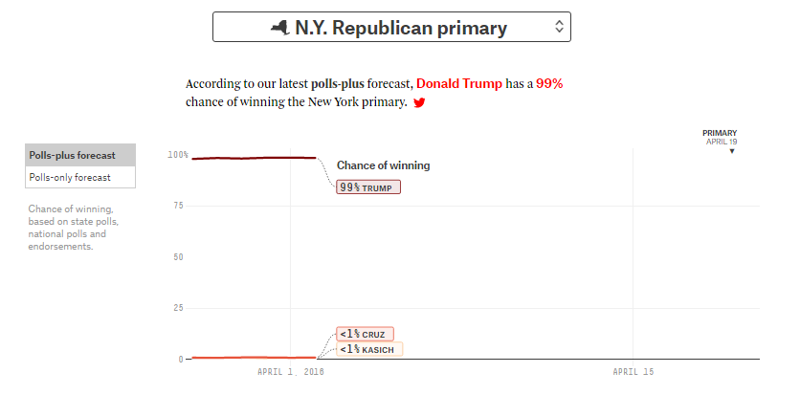
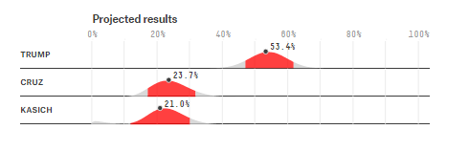
Political polling?
Not all polls are created equal...Lots of room for bias.
FiveThirtyEight creates a model based on congregating various polls and ranking them, but there’s still room for error.
FiveThirtyEight primary polling
Notes:
S

Slide 8
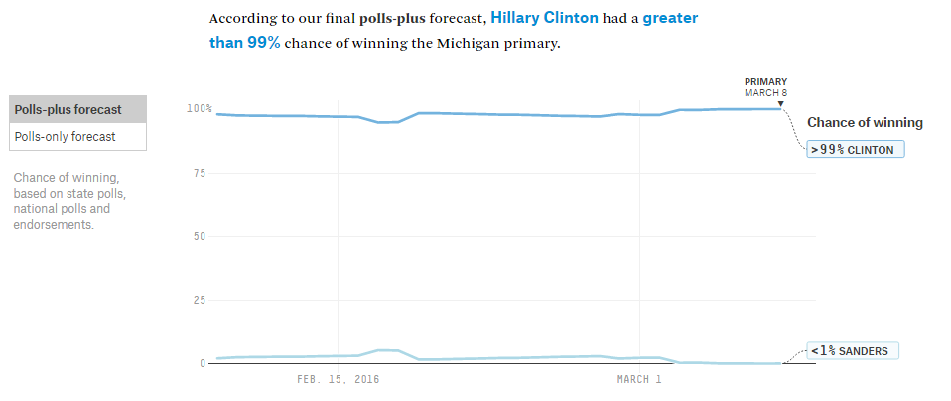
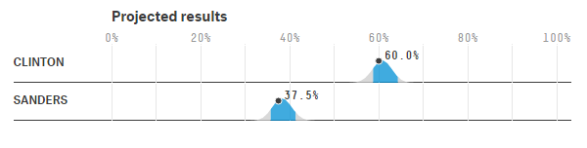
Michigan Democratic Primary
Pretty much everyone (CNN, Fox, MSNBC, 538) reported a very, very high chance of Hillary winning Michigan.
She lost by 1.5 points to Sanders.
FiveThirtyEight primary polling
Notes:
S

Slide 9
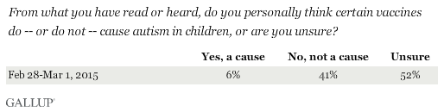
Invalid science
1998: Highly reputed science journal publishes study: Measles-mumps rubella (MMR) vaccine likely cause of autism
Article has since been retracted, but damage has been done.
Retractions in scientific articles has gone up 10x in past decade. “Most published research findings are false” — Stanford epidemiologist John Ioannidis
Causes? Competition, quality over quantity, publication bias, poor peer review, and bad statistics.
GALLUP polling in 2015
Unreliable research: trouble at the lab, The Economist Scientists Are Wrong All the Time, and That’s Fantastic, Marcos Wod, WIRED
Notes:
S
Now we go to the topic of invalid science…
In 1998, a reputable journal published the study that the MMR vaccine was a likely cause of autism. This was simply a bad study with some coincedences that led to the conclusion that was quickly overblown and exploded in the media.

Slide 10
Statistical significance, p-values, and power
Science often accepts a result of “statistical significance” if its p-value is 5%.
Media reports journal articles displaying positive correlations, but not negative correlations.
For the one MMR article that said vaccines caused autism, there were 20+ that didn’t...But which one was reported and widely discussed?
Notes:
M

Slide 11
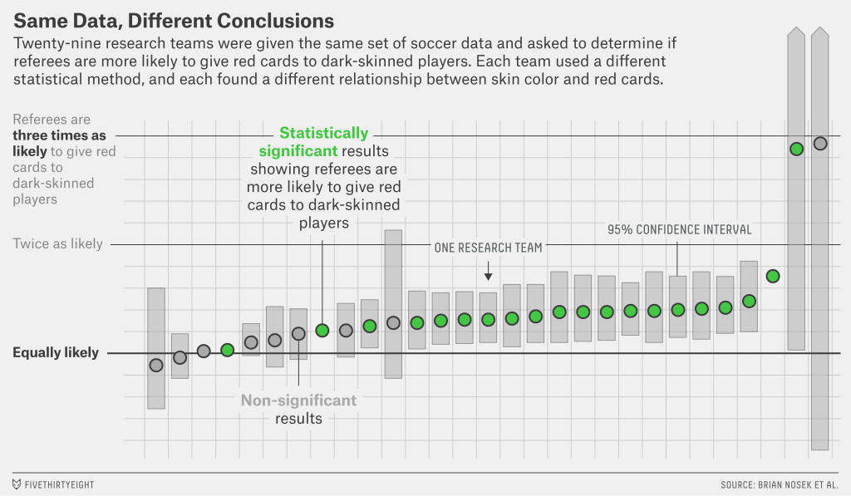
“Failure is Moving Science Forward”, FiveThirtyEight
Notes:
M

Slide 12

Correlation, Causation
“Correlation does not imply causation.”
Heard often, but practically everyone makes this mistake…
Correlation is evidence for causation, but not proof
Based on statistics, we often cannot make assumptions as to whether event A causes event B. Social data is almost always correlative.
“Bernie didn’t win these states because of the lower African-American population.” - npr
“We encourage students to participate in activities because students who participate in at least one activity raise their GPA!” - OSU tour guide
xkcd
Notes:
S

Slide 13
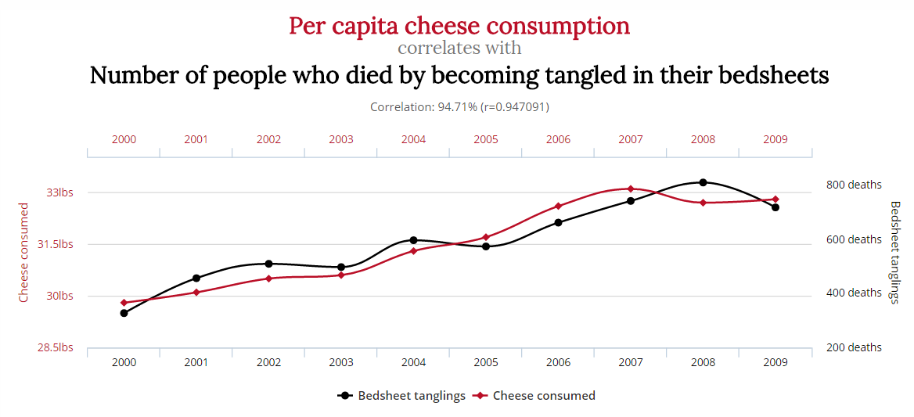
Spurious Correlations
TylerVigen.com
Notes:
S

Slide 14
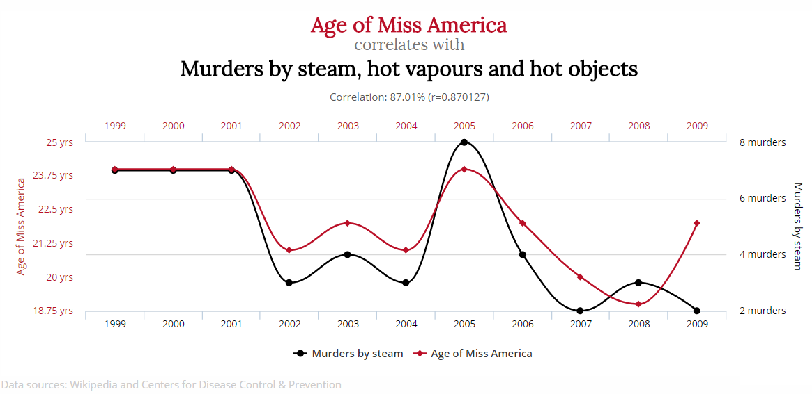
Spurious Correlations, continued
TylerVigen.com
Notes:
S

Slide 15
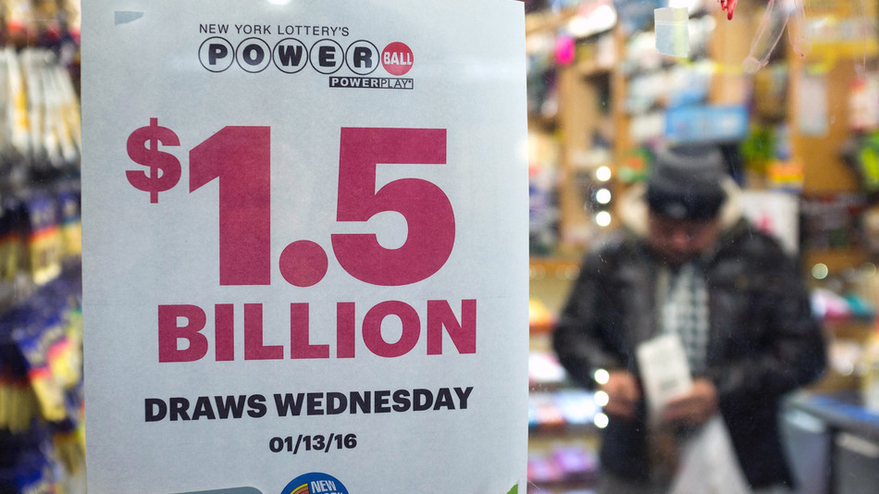
January Powerball
Recent powerball drawing: $1.59billion after 20 rollovers
1 in 292million odds — $2 / $3 tickets
Would you gamble? What are the conditions that make the powerball worth it?
Notes:
M

Slide 16

Los Angeles Times Powerball Simulator
Notes:
M

Slide 17
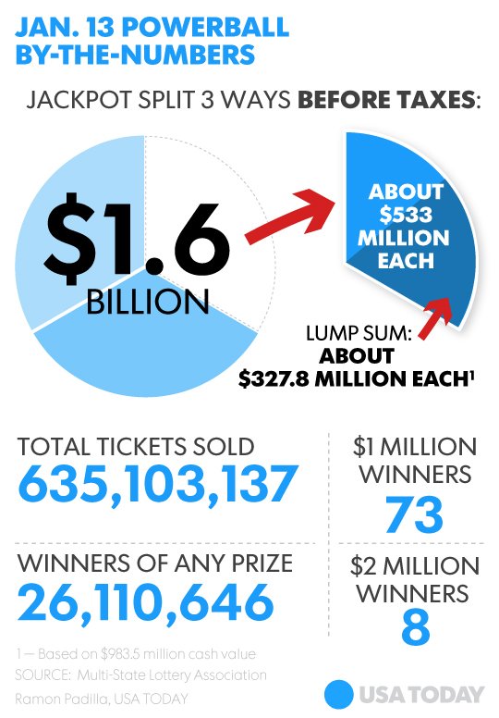
Powerball by the Numbers
Lump sum: $930 million —> ~$533 million after taxes Annuity: ~$2.958m / month
Bigger pot -> More players -> More winners -> Less expected value…
Needed $584 million to buy every one of the 292 million combinations
Nearly 70% of lottery winners go broke in 7 years.
Many have tragic stories — Jack Whittaker
Powerball graphic, USAToday
Notes:
M

Slide 18
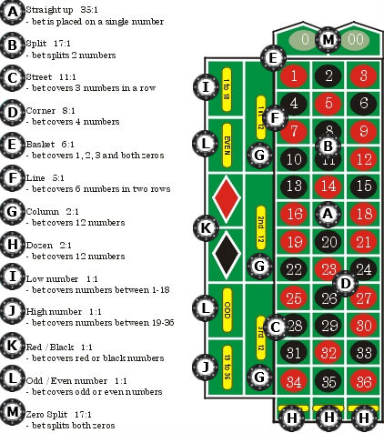
Roulette & The Martingale
Roulette, Craps, Slot Machines earn money by a built-in house edge.
The Martingale system attempts beat the house. Example:
Probability of hitting red or black: (18/38) ≈ 47%
Bet red/black. On loss, double down.
The first win recovers all previous losses.
Standard roulette odds from LiveDealer
Notes:
S

Slide 19
Martingale, continued
Play | Bet | Result | Funds
1 | $10 | LOSS, -$10 | $1000 - 10 = $990
2 | $20 | LOSS, -$20 | $990 - 20 = $970
3 | $40 | LOSS, -$40 | $970 - 40 = $930
4 | $80 | LOSS, -$80 | $930 - 80 = $850
5 | $160 | WIN, +$160 | $850 + 160 = $1010
In action: I have $1,000. I start with a $10 bet on red.
On average, I should win almost every other play. I keep betting red or black; it doesn’t matter which.
In the case that I keep losing, I make it all back when I finally win, and I’m up my $10 bet.
Notes:
S

Slide 20
Martingale, continued
With $6,500, and a $25 starting bet:
you can handle ~8 losses in a row
25(1 + 2¹ + 2² + 2³ + … + 2⁷) = $6,375
Probability: (1-.4737)⁸ = 0.59%
(Of happening in 8 spins)
Let’s test this model.
Here’s what can happen in practice:
Play | Bet | Result | Funds
55 | $320 | LOSS #6, -$320 | $10500 - 320 = $10180
56 | $640 | LOSS #7, -$640 | $10180 - 640 = $9540
57 | $1280 | LOSS #8, -$1280 | $9540 - 1280 = $8260
58 | $2560 | LOSS #9, -$2560 | $8260 - 5700 = $5700
59 | $5120 | LOSS #10, -$5120 | $5700 - 5120 = $580
Notes:
S

Slide 21
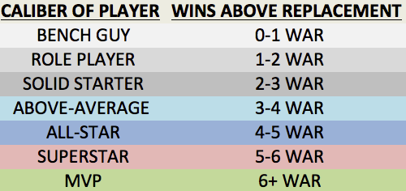
WAR! What is it good for?
W.A.R. is a popular sabermetric that has quickly become one of the most important statistics in baseball
Stands for Wins Above Replacement - Represents the # of wins a player added to a team above what a replacement player would add
How do we see WAR becoming more prevalent? Let’s examine recent MVP and Cy Young Award Winners:
WAR Table from the Bleacher Report
Notes:
M

Slide 22
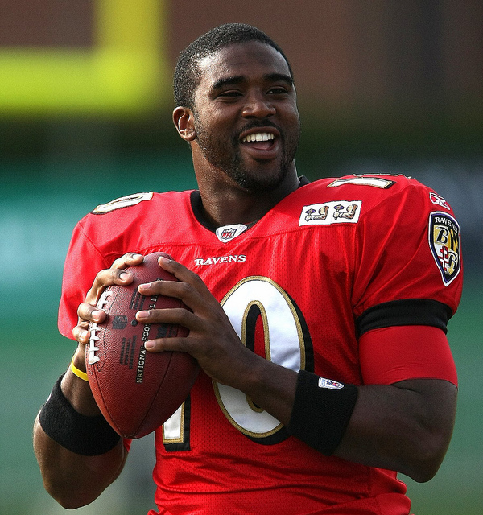
QBR
NFL uses newer sabermetric Total QBR - Quarterback Rating
QBR is a number from 1-100 that gives a QB an overall rating of his performance by factoring in situational play (1st Q v 4th Q, 3rd down, etc)
Much nicer than standard QB Rating! (Perfect QB rating is 158.3)
Let’s see if QBR translates to MVPs:
Name the QB?
photo credit: Keith Allison
Notes:
M

Slide 23

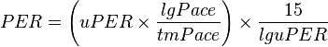
PER
The NBA also has a useful sabermetric to determine how efficient a player is, dubbed as PER
Stands for Player Efficiency Rating
A per-minute rating developed by ESPN.com columnist John Hollinger.
"The PER sums up all a player's positive accomplishments, subtracts the negative accomplishments, and returns a per-minute rating of a player's performance.
Once again, let’s see if a high PER translates to MVPs:
Equations from PER, Wikipedia
Notes:
M

Slide 24
Resources
FiveThirtyEight.com
Nate Silver’s FiveThirtyEight uses statistical analysis — hard numbers — to tell compelling stories about politics, sports, science, economics and lifestyle.
InformationIsBeautiful.net
Ideas, issues, knowledge, data — visualized!
Stats.org
Blog and newsletter about stats everyday!

Slide 25
Questions?
Thanks for listening!
Fun STEM fact: The Scholars banquet is on 4/24 and is business casual!
And sign up for rock climbing!

